Slide 1

The World Wide Web
© 2007 Prentice-Hall, Inc
2-<number>

Slide 2
The focus of this chapter is on several learning objectives
The rising tide of the Internet
The makeup of the Web
The main Web search elements
The main elements of Web research and Web research tips
The search process and some important facts to remember about Web research
How to optimize Web sites
The role of the ISP
Web fundamentals including the makeup of the URL
Internet services
© 2007 Prentice-Hall, Inc
2-<number>

Slide 3
The Beginnings of the Internet
Internet is the infrastructure that links thousands of networks together
Internet owes its existence to the Pentagon and the cold war
  Original networked sites were military installations, universities, and business firms with defense department contracts
  Initial goal was to design a network that would maintain the safe transition of data between military computers at select sites through redundant communication routes
© 2007 Prentice-Hall, Inc
2-<number>

Slide 4
The Beginnings of the Internet (cont'd)
Researchers devised a way of bundling information into packets that carried the network address of the recipient
  Each packet is sent into a so-called network “cloud” across the vast array of computers on the network
  Each computer checks to see if the information belongs to any of its clients and forwards it to the next computer to which it might belong
  Once claimed by the right computer, the packet is opened to reveal the message
  This message delivery system is moved by a protocol
© 2007 Prentice-Hall, Inc
2-<number>

Slide 5
The Beginnings of the Internet (cont'd)
  At first, Internet traffic was government related and government subsidized: No ordinary person or company could use the Internet
    April 1995 the U.S. government relinquished control of the Internet to independent governing bodies, which relaxed entry for almost everyone
© 2007 Prentice-Hall, Inc
2-<number>

Slide 6
The Beginnings of the Internet (cont'd)
  The Internet today offers a variety of services including:
    E-mail
    File transfer
    Interest group membership
    Multimedia displays
    Real-time broadcasting
    Shopping opportunities
    Access to remote computers
    Quick and easy transmission of information among computers worldwide
© 2007 Prentice-Hall, Inc
2-<number>

Slide 7
The Making of the World Wide Web
Tim Berners-Lee wrote a program that allowed information highlighted in a document to link to other documents on a computer network with a mouse click
Hypertext is text that contains keywords to connect to other documents
Keywords called links, also referred to as hyperlink, connects current document to another location in the same document or to another document on the same host computer
Hypertext for the Web can be generated with a language called HyperText Markup Language (HTML)
© 2007 Prentice-Hall, Inc
2-<number>

Slide 8
The Making of the World Wide Web (cont'd)
The World Wide Web (also known as the Web) is the universe of network-accessible information and the embodiment of the human knowledge
  A cluster of software, protocols, and standards
  An organization of files designed around a group of Internet servers programmed to handle requests from browser software that resides on users’ PC
  Single document can be perceived to stretch - weblike - throughout the world (See www.w3.org/www)
When a document is accessed the components are pulled from different computer worldwide and integrated in the document displayed on the user’s screen
© 2007 Prentice-Hall, Inc
2-<number>

Slide 9
Physical Structure of the Internet
Physical structure, or architecture, of the Internet is hierarchical
  High-speed backbones are at the top
  Bulk of Internet traffic is fed onto the backbone via network access points (NAPs)
  Regional and individual networks at the bottom
The Internet uses a common set of communication protocols called the TCP/IP (transmission control protocol / Internet protocol) suite that provide the basis for operating the Internet
© 2007 Prentice-Hall, Inc
2-<number>

Slide 10
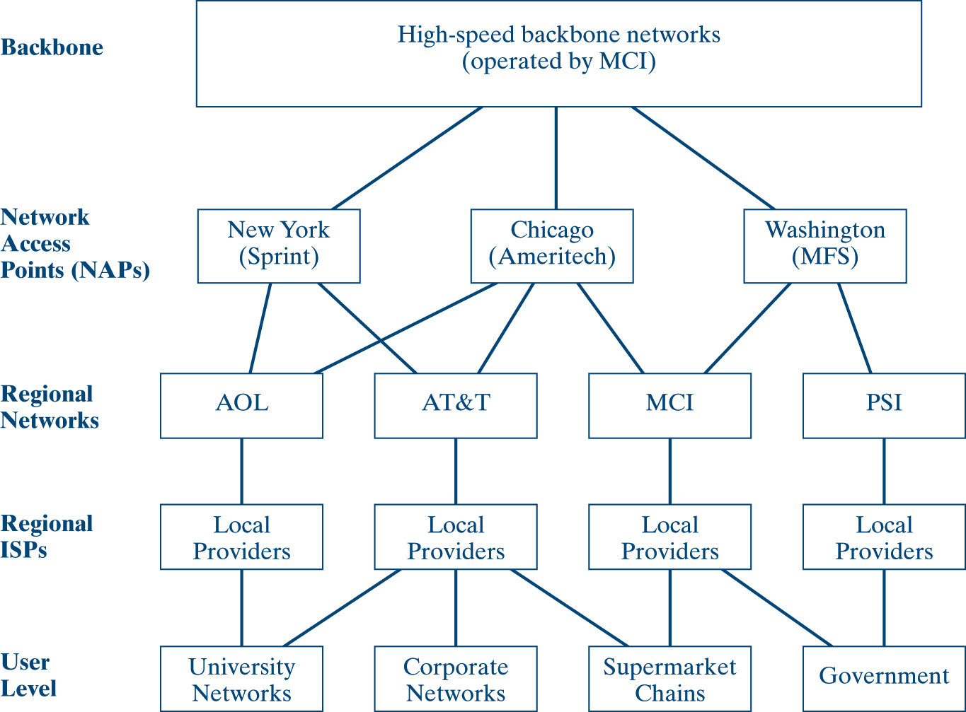
General Internet Network Architecture
© 2007 Prentice-Hall, Inc
2-<number>

Slide 11
Key Protocols Accessible on the Web
E-mail - the protocol for e-mail is Simple Mail Transport Protocol, or SMTP
HTTP - Hypertext Transfer Protocol makes possible transmission of hypertext over networks
VoIP - Voice over Internet Protocol makes it possible to place a telephone call over the Web
© 2007 Prentice-Hall, Inc
2-<number>

Slide 12
Web Search Elements
Internet contains thousands of Web sites dedicated to tens of thousands of topics
Key elements that make the search process feasible:
  Browser
  Plug-Ins
  Search Engine
© 2007 Prentice-Hall, Inc
2-<number>

Slide 13
The Browser (cont'd)
A browser is a piece of software that allows users to navigate the Web
  Netscape Navigator
  Microsoft Internet Explorer
  Firefox
  Opera
© 2007 Prentice-Hall, Inc
2-<number>

Slide 14
The Browser (cont'd)
A browser is a Web client program that uses Hypertext Transfer Protocol (HTTP) to make requests of Web servers throughout the Internet on behalf of the browser user
  Text-only mode such as Lynx
  Graphic mode involves a graphical software program that retrieves text, audio, and video
© 2007 Prentice-Hall, Inc
2-<number>

Slide 15
Plug-Ins
Software programs configured to a Web browser to improve its capabilities
Working together with plug-ins, browsers today offer seamless multimedia experiences
A popular plug-in on the Web is Adobe Shockwave flash
Microsoft developed software called Active X, which makes plug-ins unnecessary
  This software makes it possible to embed animated objects and data on Web pages
  Being a Microsoft product, Active X works best with Microsoft’s Internet Explorer browser
© 2007 Prentice-Hall, Inc
2-<number>

Slide 16
Multimedia
Since 1999, it is now common to use the Web to listen to audio and watch video - prerecorded or live off the Internet
Streaming media is audio or video that begin to play as it downloads (streaming), done through buffering
  Buffering is used to minimize the wait time between downloading and actual viewing of the material
RealPlayer and Windows Media Player are alternative options for the broadcast of real-time (live) events
Shockwave is multimedia software that allows for an entire multimedia display of audio, graphics, animation, and sound
Live Cam software essentially is a video camera that digitizes images and transmits them in real time to a Web server
Chat programs make it convenient for people to “talk” to each other in real time by typing messages and receiving responses (i.e. America Online’s Instant Messenger)
© 2007 Prentice-Hall, Inc
2-<number>

Slide 17
The Search Engine
A search process begins with a search engine:
a Web site or a database, along with the tools to generate that database and search its contents for “keywords” that describe what you’re looking for.
© 2007 Prentice-Hall, Inc
2-<number>

Slide 18
Other Definitions for Search Engines
  A software program that collects and indexes Internet resources and provides a keyword search system allowing the user to identify and retrieve resources based on words, phrases, or patterns within those documents
  A Web-based system for searching the information available on the Web
  An automated system that relies on a software agent (otherwise known as spiders, robots or crawlers) that explores the World Wide Web following links from site to site and catalogs relevant text and content, storing Web pages and creating a customized index based on the user’s query of the search engine’s database
© 2007 Prentice-Hall, Inc
2-<number>

Slide 19
More on Search Engines
Two main elements of Web research are indexes and search engines
An index can help a searcher acquire general information or gain a feel for the general topic
An index can be hierarchical or alphabetical
    Hierarchical indexing leads from general to specific topics
    Alphabetical indexing contains sources that focus on a specific topic or area of concern
© 2007 Prentice-Hall, Inc
2-<number>

Slide 20
Other Components of a Web Search Engine
A spider is a program that roams the Web from link to link, identifying and scanning pages
A spider is software unique to a search engine that allows users to query the index and returns results in relevancy-ranked order (alphabetical)
Search Engine Improvements:
  First-generation search engine returns results in schematic order, constructing a term relevancy rating of each hit and presenting search results in this order, also called “on the page” ranking.
  Second-generation search engine organizes search results by peer ranking concept, domain, or site rather than by relevancy, also called “off the page” information.
© 2007 Prentice-Hall, Inc
2-<number>

Slide 21
Search Facts to Remember
People look up Web sites with search engines.
People usually use bookmarks to visit their favorite Web sites.
A Web site must be quick and current.
A Web site should address the privacy and navigation concerns of the user.
The “bottleneck” problem
People are reluctant to pay to surf a Web site.
© 2007 Prentice-Hall, Inc
2-<number>

Slide 22
Search Engines Are Getting Smarter
Experts are working feverishly at making search engines more intelligent
An example of incorporating “intelligence” into search engines is a software agent called Query Tracker that supplements a user’s query with its own, and it gains in performance with prolonged use and feedback.
Another intelligent search engine application is IBM’s WebFountain that determines whether an entity is a person’s name, a corporate logo, a product, or a discount and then goes ahead and attaches a metadata tag to it.
On the drawing board is “thinking in pictures” as an alternative way to search the Web
© 2007 Prentice-Hall, Inc
2-<number>

Slide 23
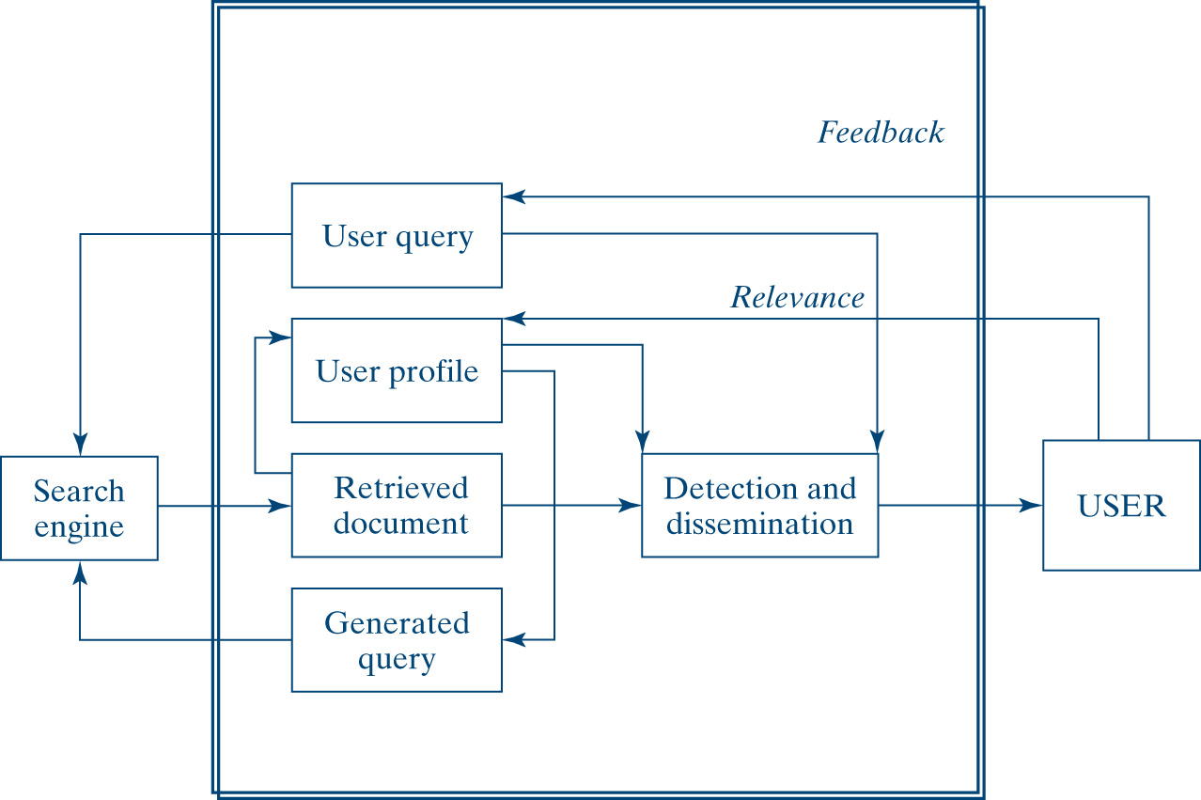
Query Tracker
Source: Adapted from Anthes, Gary H., “Search For Tomorrow” Computerworld, April 5, 2004, 26.
© 2007 Prentice-Hall, Inc
2-<number>

Slide 24
Search Engine Optimization
A way of trying to increase the number of visitors to a Web site by ranking high in the search results displayed by a search engine
One way to optimize is via hyperlinks
© 2007 Prentice-Hall, Inc
2-<number>

Slide 25
Tips for Search Engine Optimization
General keywords are nowhere as good as specific keyword phrases
Check the Web site of the competition for ideas
Think of what visitors would search for in the page you’re optimizing
Include the most important keyword phrases in heading tags on your page
Finalize the list of keyword phrases for the pages you optimize
The title tag of your page is the most important factor to consider
Visitors as well as search engines read your pages by looking at keywords to see what you have to offer
Many people have a false impression that good metatags are all that is needed to achieve good listings in the search engine
There are two metatags that can help in listing your Web site: meta keywords and meta descriptions
© 2007 Prentice-Hall, Inc
2-<number>

Slide 26
Internet Service Providers
Internet service provider (ISP) is a company that links users to the Internet for a fee
Services offered by ISPs
  Linking consumers and businesses to the Internet
  Monitoring and maintaining customers’ Web sites
  Providing network management and system integration
  Providing backbone access services for other ISPs (like PSI and UUNET)
  Offering payment systems for online purchases
© 2007 Prentice-Hall, Inc
2-<number>

Slide 27
Internet Service Providers (cont'd)
Initially, the cost for Internet access often exceeded $1,000 per month
Many of today’s ISPs offer unlimited access for as low as $5 per month
Many local governments are funding the use of the Internet because of its political, educational, and commercial benefits
The problem for some ISPs is sudden growth without advance planning to accommodate that growth
A well managed ISP requires:
  Professional management
  A highly skilled technical staff
  Healthy budget to bring the technology in line with the voracious
  Ensure a balance between creativity and control and between managing growth and a stable technical infrastructure appetite of today’s consumer
© 2007 Prentice-Hall, Inc
2-<number>

Slide 28
Stability and Reliability of the Web
No one single agency or company owns the Internet
Each company on the Internet owns its own network
Links between these companies and the Internet are owned by telephone companies and ISPs
The organization that coordinates Internet functions is the Internet Society
Internet is designed to be indefinitely extendable
Reliability depends primarily on the quality of service providers’ equipment
© 2007 Prentice-Hall, Inc
2-<number>

Slide 29
Web Fundamentals
The WWW is a global network of millions of Web servers and Web browsers connected by the hypertext transfer protocol (HTTP)
The WWW is a giant client/server system
  Content is held by Web servers and requested by clients or browsers
  Clients display the information sent by the Web server on their monitors
  Web servers provide pages of multimedia information in seconds
  The most important element of a Web site is its links to other pages within the site or across sites
© 2007 Prentice-Hall, Inc
2-<number>

Slide 30
Web Fundamentals - URLs and HTTP
Uniform Resource Locators (URLs) are central to the Web in e-commerce
A URL such as http://www.virginia.edu consists of two key parts:
  http:// (Hypertext Transport Protocol) is a protocol designator
  www.virginia.edu is the server name:
    www after the double slash tells the network that the material requested is located on a dedicated Web server
    Virginia is the name of the Web site requested
    Edu is a code for the domain of the Web server indicating that the site is an educational institution
© 2007 Prentice-Hall, Inc
2-<number>

Slide 31
Security Protocols
Two main security protocols
  Secure Sockets Layer (SSL) is a protocol for transmitting private information in a secure way over the Internet
  Secure HTTP (S-HTTP) provides various security features such as client/server authentication and allows Web clients and servers to specify privacy capabilities
Security is a major concern
© 2007 Prentice-Hall, Inc
2-<number>

Slide 32
Key Terms for Internet Literacy
Internet service provider (ISP) is a company that links users to the Internet for a fee; the entrance ramp to the Internet.
A Browser is a software program loaded on a PC that allows you to access or read information stored on the Internet. It is the client program that enables you to interface with the Internet.
Server is the destination point on the Internet where the information you are seeking is stored.
Electronic mail (e-mail) is probably the most popular and abused network application across all user categories.
© 2007 Prentice-Hall, Inc
2-<number>

Slide 33
Key Terms for Internet Literacy (cont’d )
File transfer protocol (FTP) is a standard protocol that allows you to copy files from computer to computer
Telnet is a basic Internet protocol that allows you to log on to a computer and access files from a remote location as if they were local files
Bulletin board systems (BBS) is a computer-based meeting and announcement system that allows local people to exchange information free of charge. A BBS generally has a simple interface to the Internet for users to access services like e-mail and NetNews.
© 2007 Prentice-Hall, Inc
2-<number>

Slide 34
Key Terms for Internet Literacy (cont'd)
Web pages are written in a language called Hypertext Markup Language (HTML)
  Language specifies display features that visually structure a page
  Best known for publishing static information (flows in one direction)
How to allow the user to interact with a Web site?
  Common gateway interface (CGI) scripts execute a process on the server. When executed, the script passes data (posted form) provided by the customer for verification and action.
  Java programming language or Java makes it possible for the customer to interact directly with the program on the screen.
© 2007 Prentice-Hall, Inc
2-<number>

Slide 35
Managerial Implications
The Web has changed the way business and information technology work together.
E-commerce is transforming the Internet from a “browse-and-surf” environment into a mammoth information exchange.
The important thing is to keep an eye on the technologies, as they evolve, and to be familiar with the changes before taking a dive into the Internet.
Strategize first, test the waters, and be sure you have a unique product supported by qualified staff to follow up on the Web traffic that it attracts.
© 2007 Prentice-Hall, Inc
2-<number>

Slide 36
Chapter Summary
The Web is the fastest growing, most user-friendly, and most commercially popular technology to date.
The Internet owes its existence to the Pentagon, where it originally was created for military research.
The Internet is physically hierarchical. High-speed backbones are at the top, with regional and individual networks at the bottom.
Internet service providers link commercial traffic to its destination.
© 2007 Prentice-Hall, Inc
2-<number>

Slide 37
Chapter Summary (cont’d)
The Internet has many uses; it also has many limitations.
World Wide Web is a global hypertext network of millions of Web servers and browsers connected by hypertext transfer protocol (HTTP) and its many derivatives.
It is important to learn the language of the Internet before starting an e-commerce project.
The Internet and the Web have changed the way business and technology work together.
© 2007 Prentice-Hall, Inc
2-<number>

